Slide 1

CC 141 Discrete Structures Department of Computer Science School of Systems and Technology University of Management and Technology Lahore, Pakistan

Slide 2
Section 1.4 PREDICATES and QUANTIFIERS

Slide 3
Propositions
Proposition: a declarative statement that is either true or false
Example:
The sky is red
ALLAH is one
Boolean variable: A variable (usually p, q, r, etc.) that represents a proposition

Slide 4
Propositions
X+3 > 4 is a PROPOSITION?
NO
Open Statement
because value of X is unknown

Slide 5
Propositions ?
Statements involving variables.
Example:
1. x > 3
2. x = y + 3
x + y = z
computer x is under attack by an intruder
Need for additional rules

Slide 6
Propositional Function - Predicate
A predicate in Discrete Structures is a function with one or more parameters:
Its truth value can be True / False
Its value depends upon its variables’ values
Variables can have Boolean values
Example:
P(x) = x² > 10
P (x) | x | Truth Value
x² > 10 | 1
x² > 10 | 2
x² > 10 | 3
x² > 10 | 4
False
False
False
True

Slide 7
Predicates
Hence
A declarative sentence which contains one or
more variables, and is not a proposition,
but becomes a proposition when the variables
in it are replaced by certain allowable choices

Slide 8
PREDICATES
P(x):= word x contains the letter n
P(panama) T/F?
P(swiss) T/F?

Slide 9
Example
Let A(x) denote the statement
“Computer x is under attack by an intruder.”
Suppose that of the computers on campus, only CS2 and MATH1 are currently under attack by intruders.
What are truth values of A(CS1), A(CS2), and A(MATH1)?

Slide 10
PREDICATES
A predicate may involve more than one variables
n-ary Predicate
Value of a Propositional Function
(True/False)

Slide 11
Example (more than1variable)
Let Q(x, y) denote the statement “x = y + 3.”
What are the truth values of the propositions
Q(1, 2) and Q(3, 0)?
Q(1, 2) : 1=2+3, False
Q(3, 0): 3=0+3 True

Slide 12
Example (more than 1 variable)
Let A(c, n) denote the statement
“Computer c is connected to network n,”
where c represents a computer and
n represents network.
Suppose that computer MATH1 is connected to network CAMPUS2,
but not to network CAMPUS1.
What are the values of A(MATH1, CAMPUS1) and
A(MATH1, CAMPUS2)?

Slide 13
PREDICATES
Let R(x, y, z) denote the statement
“x + y = z.”
What are the truth values of the propositions
R(1, 2, 3)
R(0, 0, 1)

Slide 14
Propositional functions
Let P(x) = “x is a multiple of 5”
For what values of x is P(x) true?
Let P(x) = x+1 > x
For what values of x is P(x) true?
Let P(x) = x + 3
For what values of x is P(x) true?

Slide 15
Universe of Discourse
Consider the example x > 3.
Does it make sense to assign to x the value “blue”?
Predicates become propositions once every
variable is bound by assigning it a value from
the Universe of Discourse “U” (aka domain)

Slide 16
Example
Let U= Z, the integers = { . . -2, -1, 0 , 1, 2, . . .}
P(x): x > 0 is the predicate.
propositions where x is assigned a value:
P(-3)
P(0)
P(3)

Slide 17
PREDICATES
Every student of this class is a bright student
Ahmad is a student of this class
Ahmad is a bright student
T / F ?
Need for additional rules

Slide 18
Quantifiers
A predicate is transformed into a proposition when we assign a fixed set of values to its variables. The predicate then can have a truth value as either True or False.
Another way to make a predicate into a proposition is to quantify it.
That is, the predicate is true (or false) for all possible values in the universe of discourse or for some value(s) in the universe of discourse
A quantifier is “an operator that limits the variables of a proposition”
Area of logic that deal with predicate and quantifiers is called predicate calculus.

Slide 19
Quantifiers
Universal Quantifier
Existential Quantifier

Slide 20
Universal Quantifier … ∀
The universal quantification of a predicate P(x) is the proposition
“P(x) is true for all values of x in the universe of discourse (domain)”
notation ∀x P(x) which can be read “for all x”

Slide 21
Universal Quantifiers … ∀
If the universe of discourse is finite i.e.,
n ∈ {n₁, n₂, n₃, …., n_{k}}
then the universal quantification is nothing but the conjunction of P(x) for all values of x.
∀xP(x) ↔ P(n₁) ∧ P(n₂) ∧ P(n₃) ∧ ….. ∧ P(n_{k})

Slide 22
Universal Quantifier
An element for which P(x) is false is called
a counterexample of ∀x P(x)
True
When No False example found
False
When 1 False example found

Slide 23
Expressing words
We can state in following ways: –
∀x P(x) : x+1 > x
“for all values of x, P(x) is true”
“for all values of x, x+1>x is true”
Expressing words:
“for all,” “for every,” “all of,”
“for each,” “given any,” “for arbitrary,”
“for any.”

Slide 24
Universal Quantifier
What does the statement
∀x N(x)
mean if
N(x) is “Computer x is connected to the network”
and
the domain consists of all computers on campus?
“Every computer on campus is connected to the network.”

Slide 25
Translation from English to Logical Expressions Example1 …
Let x = a student
P(x) = “x must take Discrete Mathematics course”,
The Universe of discourse is all UMT students.
Express the statement mathematically: “Every student must take discrete mathematics course”
∀x P(x)
The above proposition with have its Truth value equal to True only if P(x) is True for all values of x.

Slide 26
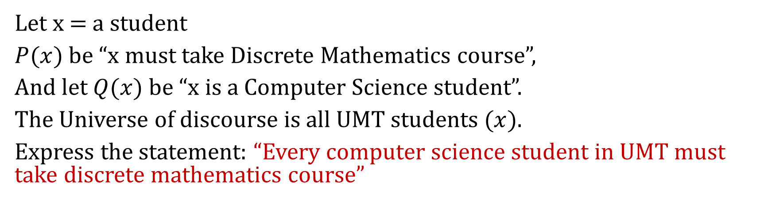
Example2…
Let x = a student
$P(x)$ be “x must take Discrete Mathematics course”,
And let $Q(x)$ be “x is a Computer Science student”.
The Universe of discourse is all UMT students ($x$).
Express the statement: “Every computer science student in UMT must take discrete mathematics course”
∀x(Q(x) → P(x))
The above proposition with have its Truth value equal to True only if it is True for all values of x.
In what scenario, the above proposition will have False as its truth value?

Slide 27
Example3
Let x = a student in UMT
Let P(x) be “x must take Discrete Mathematics course”,
And let Q(x) = “x is a Computer Science student”.
The Universe of discourse is all UMT students.
Express the statement: “Every student must take a discrete mathematics course or be a computer science student”
∀x(Q(x) ∨ P(x))

Slide 28
Universal Quantifier …. Truth Value … Example 1
Let P(x) be the statement “x + 1 > x.”
What is the truth value of the quantification ∀x P(x), where the domain consists of all real numbers?
True
(no value of x found for which propositional function is false)

Slide 29
Example 2
Let Q(x) be the statement “x < 2.” What is the truth value of the quantification ∀x Q(x), where the domain consists of all real numbers?
False
Counter example
Q(3) : 3<2 , false.
If you found any false example then ∀x Q(x) is false.

Slide 30
Example 3
Suppose that P(x) is “x² > 0.” show statement
∀x P(x) is false where the domain consists of all integers.
False
x = 0 is a counterexample.

Slide 31
Example 4
What is the truth value of ∀x P(x), where P(x) is the statement “𝑥² < 10” and the domain is positive integers not exceeding 4?
Solution:
False
Counter example
P(4) : 4² < 10, is false,
Thus ∀x P(x) is false.

Slide 32
Existential Quantifier … ∃
The existential quantification of a predicate P(x) is the proposition
“P(x) is True for some value of x in the universe of discourse”
OR
“There exists an x in the universe of discourse such that P(x) is true.”
notation ∃x P(x) existential quantifier read as “there exists an x”
True
When 1 true example found
False
When No true example found

Slide 33
Existential Quantifier … ∃
If the universe of discourse is finite i.e.,
n ∈ {n₁, n₂, n₃, …., n_{k}}
then the existential quantification is nothing but the disjunction of P(x) for all values of x.
∃ xP(x) ↔ P(n₁) ∨ P(n₂) ∨ P(n₃) ∨ ….. ∨ P(n_{k})
The above proposition with have its Truth value equal to True only
if P(x) is True for one or more values of x.

Slide 34
Expressing words
We can state in following ways: –
∃x P(x)
“there exists (a value of) x such that P(x) is true”
“for at least one value of x, x+1>x is true
For some x P(x) is true
Expressing words: “there exists,” “for some,” “for at least one,” or “there is”

Slide 35
Example1 …
Let x = a politician
P(x) = “x is honest”,
The Universe of discourse is all politicians in our country.
Express the statement mathematically: “Some politicians in our country are honest.”
∃xP(x)
The above proposition with have its Truth value equal to True only if you are able to find at least one honest politician in our country.
In what scenario, the above proposition will be False?

Slide 36
Exercise
x = a student
P(x) = x is honest
Q(x) = x is an opportunists
R(x) = x likes to cheat
The universe of discourse is all students in my class.
All students are honest
Some students are opportunist
A few students are opportunist but they do not like to cheat
Some of the students are opportunist and they like to cheat too
All students are honest but some of them are opportunists too

Slide 37
Exercise
x = a teacher
P(x) = x is honest
Q(x) = x is lazy
R(x) = x evaluates the student tasks on time
The universe of discourse is all teachers in a University.
All teachers are honest
Some teachers are lazy
A few teachers are lazy and they do not evaluate students tasks on time
A few teachers are lazy but they evaluate students tasks on time
A teacher is not honest and he is lazy too

Slide 38
Example 1
Let P(x) denote the statement “x > 3.” What is the truth value of the quantification ∃x P(x), where the domain consists of all real numbers?
True
Example
P(4): 4>3, True

Slide 39
Example 2
Let Q(x) denote the statement “x = x+1.”What is the truth value of the quantification ∃x Q(x), where the domain consists of all real numbers?
False
(no value of x found for which propositional function is True)

Slide 40
Example 3
What is the truth value of ∃x P(x), where P(x) is the statement “𝑥² > 10” and the universe of discourse consists of the positive integers not exceeding 4?
True
Example
P(4): 4²>10, True

Slide 41
Uniqueness Quantifier … ∃!
“There exists a unique x such that P(x) is true.”
i.e. “there is exactly one” or “there is one and only one.”
denoted by ∃! or ∃1.
Example: Let P(x) denote x - 1 = 0 and U are the integers.
Then ∃!x P(x) is
True.
Example: Let P(x) denote x > 0 and U are the integers.
Then ∃!x P(x) is
False

Slide 42
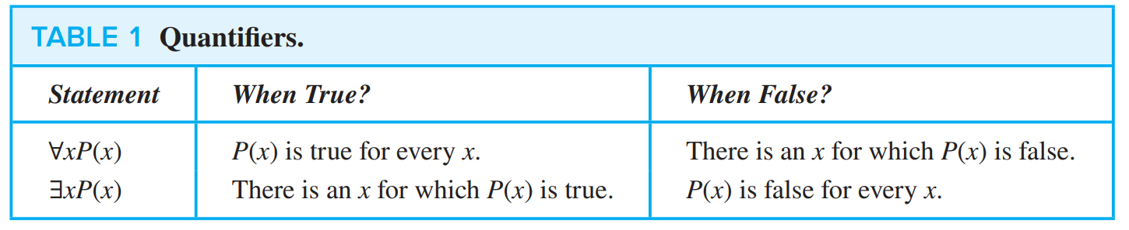
QUANTIFIER

Slide 43
Sets and Notations
Set | Symbol
Set of Natural Numbers | N
Set of Integers | Z
Set of Positive Integers | Z⁺
Set of Negative Integers | Z⁻
Set of Real Numbers | R
Set of Rational Numbers | Q

Slide 44
Examples – Express in Mathematical Notation
Product of two negative integers is positive.

Slide 45
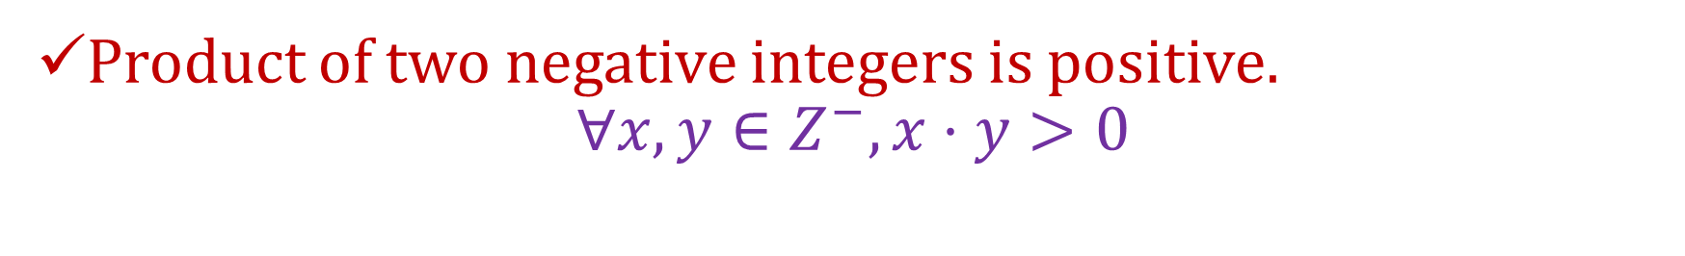
Examples – Express in Mathematical Notation
Product of two negative integers is positive.
$$∀x,y∈Z^{−}, x⋅y>0$$

Slide 46
Examples – Express in Mathematical Notation
Product of two negative integers is positive.
Average of two positive integers in positive.

Slide 47

Examples – Express in Mathematical Notation
Product of two negative integers is positive.
Average of two positive integers is positive.
$∀a,b∈Z^{+}, \frac{\left(a+b\right)}{2}≥0$

Slide 48
Examples – Express in Mathematical Notation
Product of two negative integers is positive.
Average of two positive integers in positive.
The difference of two negative integers is not necessarily negative.

Slide 49
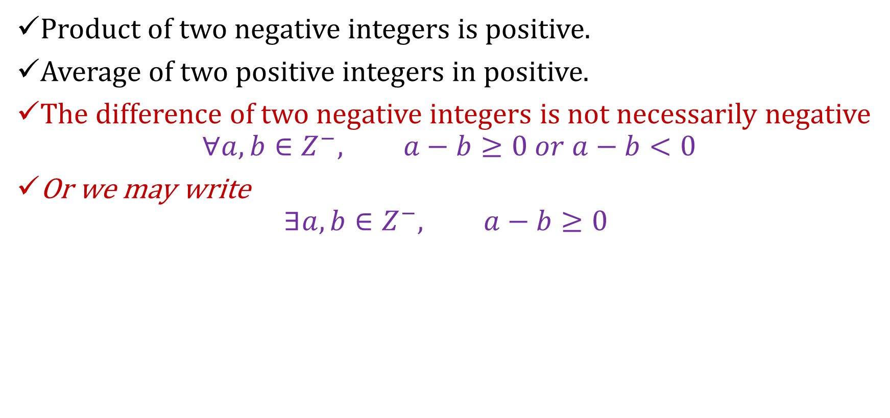
Examples – Express in Mathematical Notation
Product of two negative integers is positive.
Average of two positive integers in positive.
The difference of two negative integers is not necessarily negative
$$∀a,b∈Z^{−}, a−b≥0 or a−b<0$$
Or we may write
$$∃a,b∈Z^{−}, a−b≥0$$

Slide 50
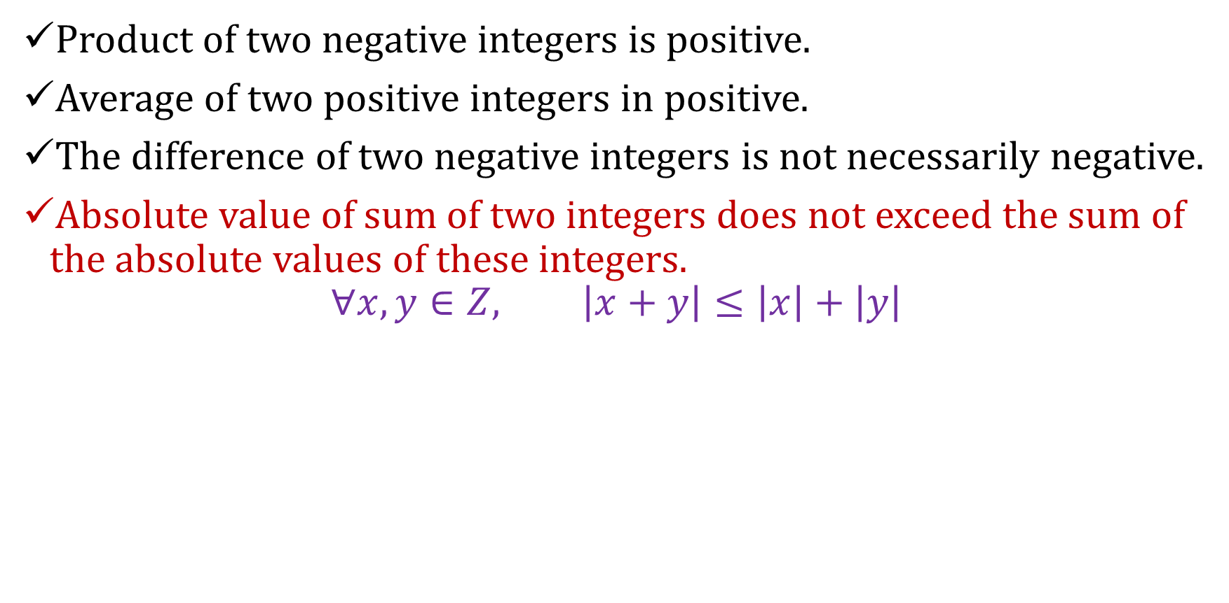
Examples – Express in Mathematical Notation
Product of two negative integers is positive.
Average of two positive integers in positive.
The difference of two negative integers is not necessarily negative.
Absolute value of sum of two integers does not exceed the sum of the absolute values of these integers.
$$∀x,y∈Z, \left|x+y\right|≤\left|x\right|+\left|y\right|$$

Slide 51
Quantifiers with Restricted Domains
An abbreviated notation is used to restrict the
domain of a quantifier.
a condition which variable must satisfy is
included after the quantifier.
Example:
∀x < 0 (𝑥²> 0)
∃z > 0 (𝑧²= 4)

Slide 52
Quantifiers with Restricted Domains
1. ∀x < 0 (𝑥²> 0)
Means “For every x in the domain with x < 0, 𝑥²> 0”
Proposition is same as: ∀x (x < 0 → 𝑥² > 0).
2. ∃z > 0 (𝑧²= 4)
Means “There is some z in the domain with z > 0, 𝑧²= 4
Proposition is same as: ∃z (z > 0 ∧ 𝑧² = 4).

Slide 53
Binding Variables
If there is a quantifier used on a variable x, we
say the variable is bound. Else it is free.
Ex: In ∃ x (x + y = 1 ) , x is bound and y is free
If all variables in a propositional function are bound or set equal to a particular value , the function becomes proposition
– Ex: ∀ y ∃ x (x + y = 1 ) is a proposition

Slide 54
Scope of Quantifiers
Proposition ∀ y ∃ x (x + y = 1 ) with two quantifiers,
Where
∀ y is applied to ∃ x (x + y = 1 ), and
∃ x is applied to x + y = 1
The part of the logical expression where a quantifier is applied is called the scope of that quantifier

Slide 55
Example
∃x(x + y = 1)
∃x P(x) ∨ Q(x)
∃x (P(x) ∨ Q(x))
(∃x P(x)) ∨ (∀x Q(x))

Slide 56
Precedence of Quantifiers
Higher than all logical operators from propositional calculus

Slide 57
Precedence of Quantifiers
The quantifiers ∀ and ∃ have higher precedence than all logical operators from propositional calculus.

Slide 58
Precedence of Quantifiers
For example,
∀xP(x) ∨ Q(x) is the disjunction of ∀xP(x) and Q(x).
In other words, it means (∀xP(x)) ∨ Q(x)
rather than ∀x(P(x) ∨ Q(x)).

Slide 59
Logical Equivalences
Statements involving predicates and quantifiers are logically equivalent if and only if they have the same truth value no matter which predicates are substituted into these statements and which domain of discourse is used for the variables in these propositional functions.

Slide 60

Logical Equivalences
We use the notation
S ≡ T
to indicate that two statements S and T involving predicates and quantifiers are logically equivalent.

Slide 61
Logical Equivalences
We can distribute a universal quantifier over a conjunction
∀x (P(x) ∧ Q(x)) ≡ ∀x P(x) ∧ ∀x Q(x)
We can also distribute an existential quantifier over a disjunction
∃x (P(x) ∨ Q(x)) ≡ ∃x P(x) ∨ ∃x Q(x)

Slide 62
Logical Equivalences
We cannot distribute a universal quantifier over a disjunction
∀x (P(x) ∨ Q(x)) !≡ ∀x P(x) ∨ ∀x Q(x)
Similarly,
we cannot distribute an existential quantifier over a conjunction
∃x (P(x) ∧ Q(x)) !≡ ∃x P(x) ∧ ∃x Q(x)

Slide 63
Negating Quantified Expressions
De Morgan's Laws

Slide 64
Quantifiers – Negation
Let P(x) be a predicate then the following hold:
¬∀xP(x) = ∃x¬P(x)
¬∃xP(x) = ∀x¬P(x)
These are essentially the quantified versions of De Morgan’s Law. (In fact if the universe of discourse is finite, it is exactly De Morgan’s Law)

Slide 65
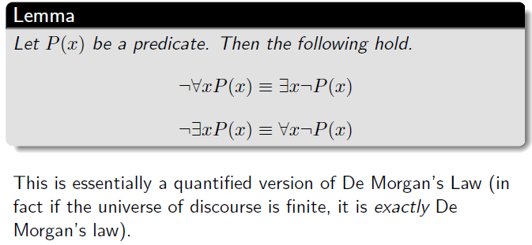
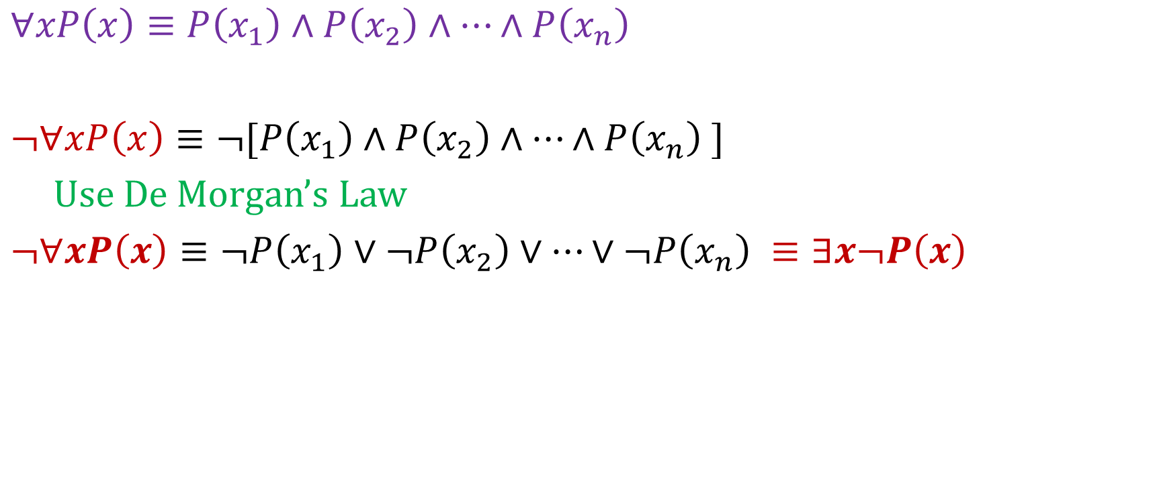
Quantifiers – Negation
$∀xP\left(x\right)≡P\left(x_{1}\right)∧P\left(x_{2}\right)∧…∧P\left(x_{n}\right)$
$¬∀xP\left(x\right)≡¬[P\left(x_{1}\right)∧P\left(x_{2}\right)∧…∧P\left(x_{n}\right) ]$
Use De Morgan’s Law
$¬∀xP\left(x\right)≡¬P\left(x_{1}\right)∨¬P\left(x_{2}\right)∨…∨¬P\left(x_{n}\right) ≡∃x¬P\left(x\right)$

Slide 66
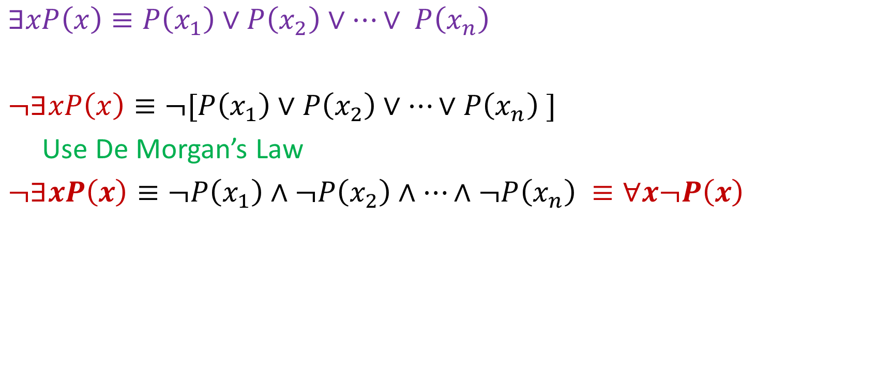
Quantifiers – Negation
$∃xP\left(x\right)≡P\left(x_{1}\right)∨P\left(x_{2}\right)∨…∨ P\left(x_{n}\right)$
$¬∃xP\left(x\right)≡¬[P\left(x_{1}\right)∨P\left(x_{2}\right)∨…∨P\left(x_{n}\right) ]$
Use De Morgan’s Law
$¬∃xP\left(x\right)≡¬P\left(x_{1}\right)∧¬P\left(x_{2}\right)∧…∧¬P\left(x_{n}\right) ≡∀x¬P\left(x\right)$

Slide 67
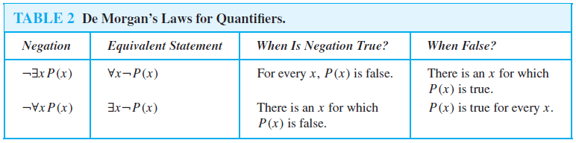
Negating Quantified Expressions
De Morgan's Laws for Quantifiers

Slide 68
Example …1
What is the negation of:
There is a hard-working student.

Slide 69
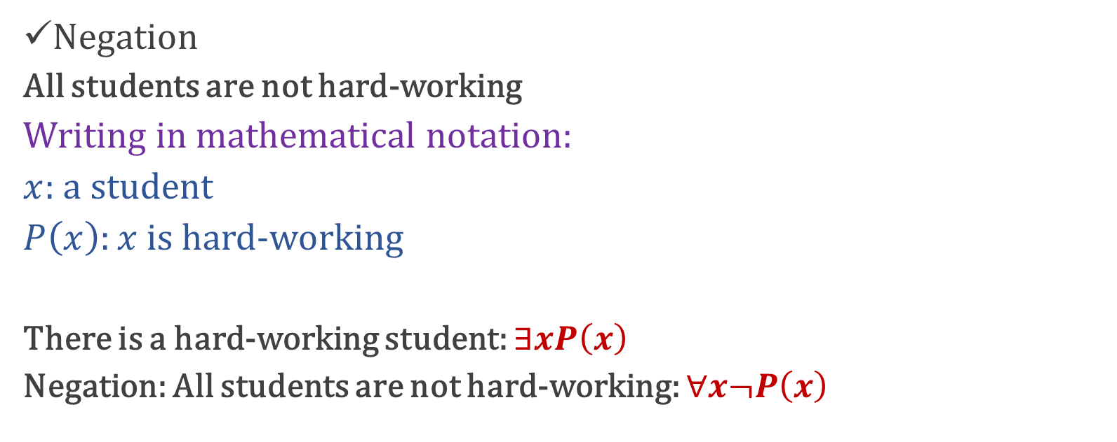
Example … Solution
What is the negation of:
There is a hard-working student.
Negation
All students are not hard-working
Writing in mathematical notation:
$x$: a student
$P\left(x\right):x$ is hard-working
There is a hard-working student: $∃xP\left(x\right)$
Negation: All students are not hard-working: $∀x¬P\left(x\right)$

Slide 70
Example …2
What is the negation of:
All Lahoris like to eat chicken karahi.

Slide 71
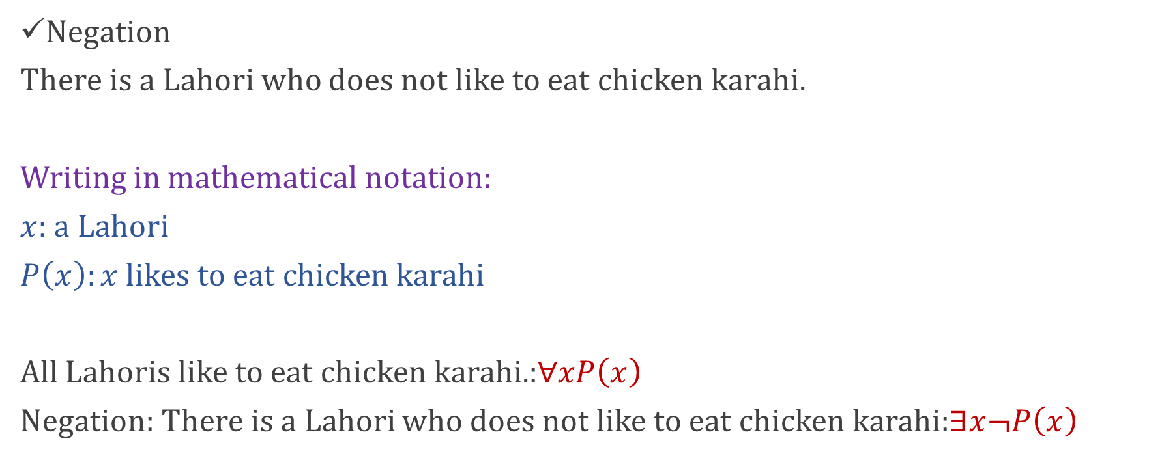
Example … Solution
What is the negation of:
All Lahoris like to eat chicken karahi.
Negation
There is a Lahori who does not like to eat chicken karahi.
Writing in mathematical notation:
$x$: a Lahori
$P\left(x\right):x$ likes to eat chicken karahi
All Lahoris like to eat chicken karahi.:$∀xP\left(x\right)$
Negation: There is a Lahori who does not like to eat chicken karahi:$∃x¬P\left(x\right)$

Slide 72
Example …3
What is the negation of the following statement?
$$∀x (x2>0)$$
$$Negation: ∃x \left(x^{2}≤0\right)$$

Slide 73
Example …4
What is the negation of the following statement?
$$∃x \left(x^{2}=5\right)$$
$$Negation:∀x\left(x^{2}≠5\right)$$

Slide 74
Exercises….
Write the following statements into logical expressions. Then write their negation statements too.
Everyone of our class has visited Germany.
No one in Lahore owns plane and a car.
Everyone in our class is not happy about his grades.
No one in your school owns both a bicycle and a motorcycle.
There is a student in our class who is not thankful to his parents.
Someone in our class was born in Gujranwala.

Slide 75
Negating Quantified Expressions
Show this logical equivalence step by step:
￢ ∀x (P(x) → Q(x)) ≡ ∃x (P(x) ∧ ￢Q(x))

Slide 76

Summary
The topics we covered so far:
Predicate and Quantifiers
Negating Quantifiers
Translation English to Logical statements
Quantifiers with restricted domains
Binding Variable
Scope of Quantifiers

